Slide 1

PROJECT REPORT ON:-
HOTEL MANAGEMENT SYSTEM
PROJECT REPORT SUBMITTED BY:
KARTHIK ARJI-14CS01001
KARTHIK RAO-14CS01022

Slide 2
INDEX
Introduction and requirement analysis
Conceptual design
Software Development Paradigm
ER Diagram
Database Design
Forms and their Coding
Future Aspect
Conclusion

Slide 3
INTRODUCTION:-
This project introduces THE HOTEL MANAGEMENT SYSTEM. It explains how room booking is done in a hotel.
On the other hand there has to be a check out system for those seats which had been booked before hands and are to be left out now.
The Hotel Department maintains the seat availability and booking details in a certain Database. It contains the details of the different rooms available in that particular hotel, for instance there might be rooms classified into single, double and triple bed rooms.
The Database also consist a record of the seats that are already booked and the ones yet to be booked.
A bright feature of this software is the inclusion of The Time Scheduling feature, which makes it more user friendly, more efficient and provides it high flexibility.

Slide 4






Software development paradigm:-
The software development paradigm used in developing this software is waterfall. In this every phase is executed very carefully one after another.
Any other SDLC model follows this technique as its basic unit. The various phases of waterfall model which model with its working is as follows:

Slide 5
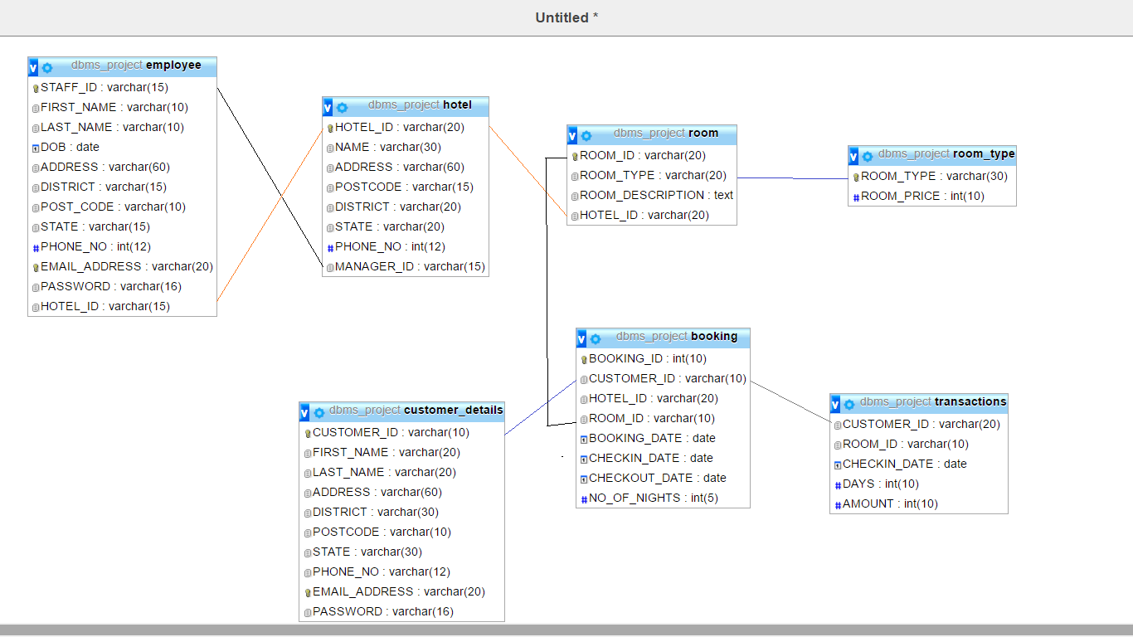

Slide 6
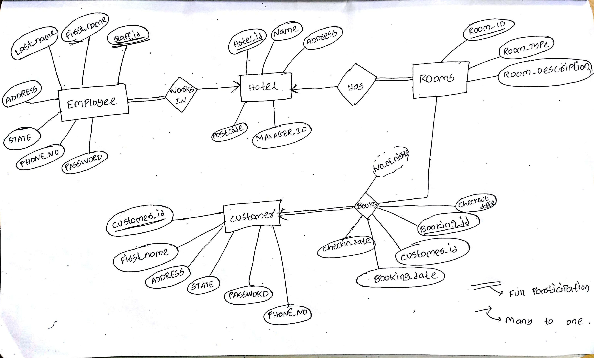

Slide 7
Requirement analysis
• Disadvantages of manual system
- Large storage space
Human and computational errors
- Poorly generated records
- Poor communication
- Difficulty in data analysis
• To enable online booking via the internet.
• Ensure efficient and reliable communication within the hotel.
• Avoid data entry errors by use of input masks.
• Enforce security measures to avoid unauthorized access to guest records.
• Enable fast and easy retrieval of guest records and data for fast reference activities.

Slide 8
Design process:
• A conceptual design to entire problem of managing a hotel.
• Figuring the data storage requirements for process.
• Identifying the entities of storage.
• Specifying the entities and fields.
• Figuring all the actions or processes to achieve the required functionalities.
• Relating the data and actions to make a Entity-Relationship model.

Slide 9
Complete Technical requirements:
A relational database to implement the conceptual design of the data storage requirement of the application.
• front end: HTML and CSS
• client side: php
•Backend: Mysql
Databse:XAMPP server database

Slide 10
Other Features
System Setup & Master Files Maintenance
Database Maintenance
Hotel Room Reservation
Hotel Room Availability
Hotel Check-In & Check-Out
Billing & Invoicing System
Management Reports

Slide 11
Future aspect:-
In future our software could be further enhanced by providing our customers with the facility of booking more than one rooms at the same time and keeping his/her customer_id the same.
Apart from that in future our software can also be used for hotels that provide both lodging and fooding facilities, in such case our software would also keep a record of food supplements and recruited staffs in our database.
In other words our software would provide staff management as well as restaurant management.
The inclusion of these features would definitely make our software highly demanding and would be a grand success in practical field.

